Slide 1
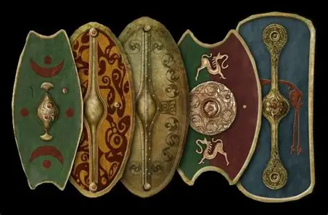
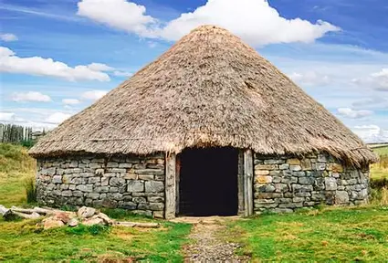




A walk through time!...
-Decorate Roman faces/ masks
-Create Roman mosaics
-Create a Celtic roundhouse
-Try traditional Roman dances!
-Develop your confidence through performing like your in an amphitheatre.
-Write a diary entry as a day in the life of a Roman/ Celtic child…
-Learn the Roman numerals
-Learn about the Roman Gods
-Use sustainable materials to design a Celtic shield

